Slide 1


Seizure Prediction Team 1 (Sprint 3) By: Rashmi, Matthew, Shruti 28 Nov, 2016
GitHub Link
Trello Link

Slide 2
Sprint 3- Original Tasks
Signal processing
Select between Neural Network and Feature Extraction
Select Features to be extracted and add to code
Android App
Connect Database to the app
App screen layouts for Patient and Emergency contact

Slide 3
Sprint 3- Accomplishments
Signal processing
Ultimately selected Feature Extraction method over Neural networks
Successfully executed the scripts on the entire dataset on the Shared Computing Cluster
Android App
Connect Database to the app
Implemented screen layouts and functionalities of app
Data
Processing
Database
App
Notification

Slide 4
Feature Extraction
Spectrum and Shannon's entropy
Entropy reflects how well one can predict the behaviour of each respective part of the trajectory from the other. Basically, higher entropy indicates more complex or chaotic systems, thus, less predictability
Spectral edge power of 50% power up to 40Hz.
Frequency below which x percent of the total power of a given signal are located. (typically x is in the range 75 to 95.)
Shannon's entropy at dyadic frequency bands.
Using a Discrete Wavelet Transform, bandpass filters were applied to the FFT of the data channels and Shannon’s Entropy in each band was calculated.
Spectrum correlation across channels at dyadic frequency bands.
Measures the similarity of the spectrum of each channel to other channels
Fractal dimensions
Contains three estimates of the fractal index H of the input signal

Slide 5
Feature Extraction
contains three estimates of the fractal index H of the input signal X
Time-series correlation matrix and its eigenvalues
Measures the similarity of signal values compared to previous signal values within each channel
Hjorth parameters
Activity, mobility and complexity
Statistical moments: skewness and kurtosis
Skewness is a measure of the asymmetry of the probability distribution of a real-valued random variable about its mean.
Kurtosis is the sharpness of the peak of a frequency-distribution curve.
Additional features are currently being evaluated and added to the code including Coherence and Haart Wavelet Coefficients (cont. in Sprint 4)

Slide 6
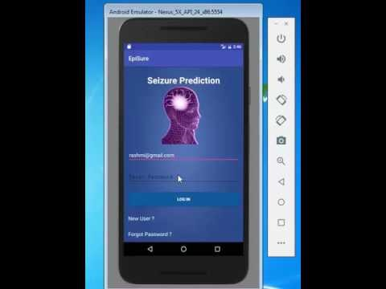
DEMO

Slide 7
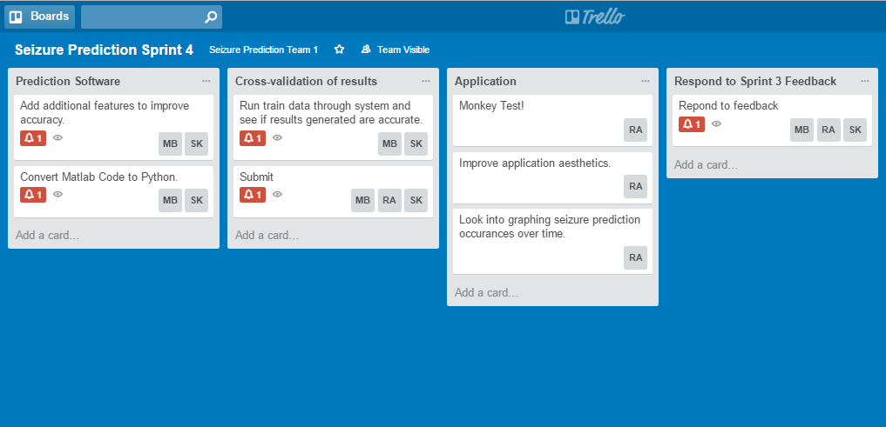
Sprint 4 Plan

Slide 8
Thank you

